Slide 1
OneSharedStory Database Design
By Matthew Edwards and Colin Warner
2/22/2022

Slide 2
The Problem
One Shared Story connects families to their ancestry. Specifically, they help the African American community gain insight into their ancestry prior to emancipation. Our objectives are to:
Standardize the way volunteers transcribe data
Store transcribed data in a database
Create an interactive search tool

Slide 3
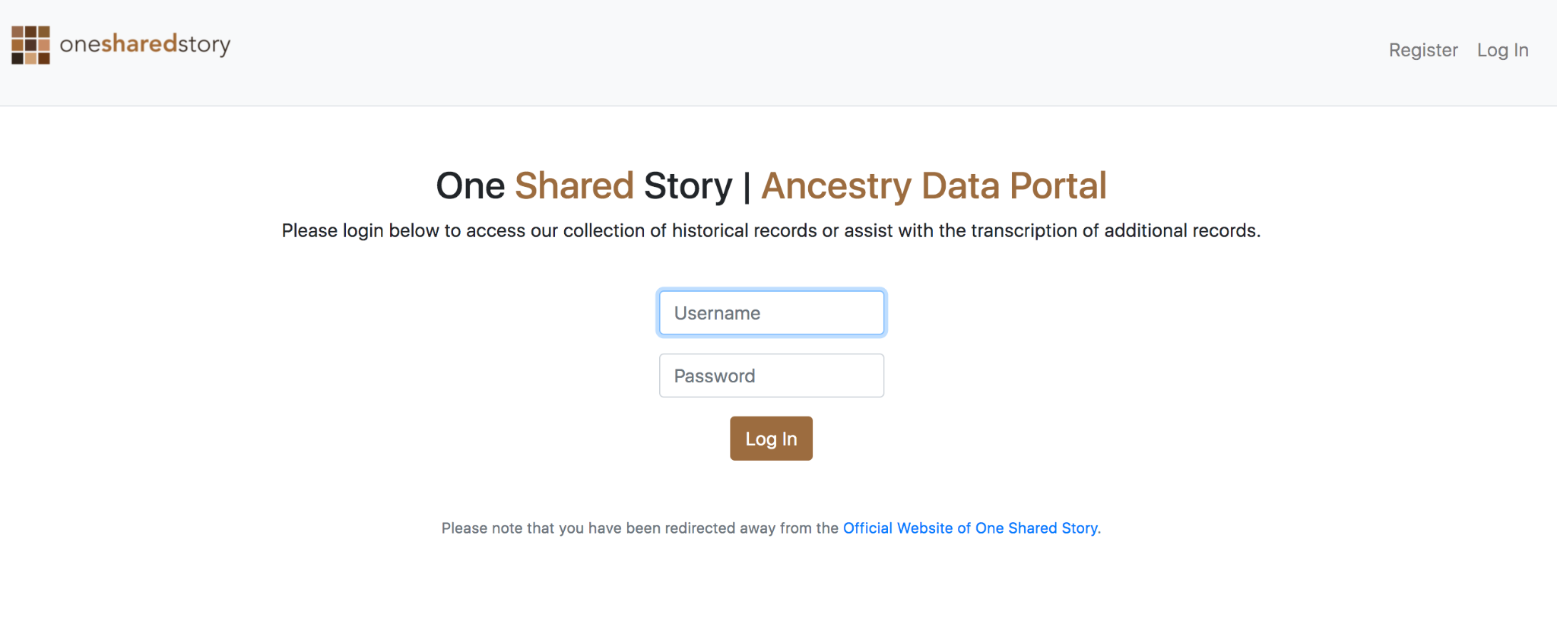
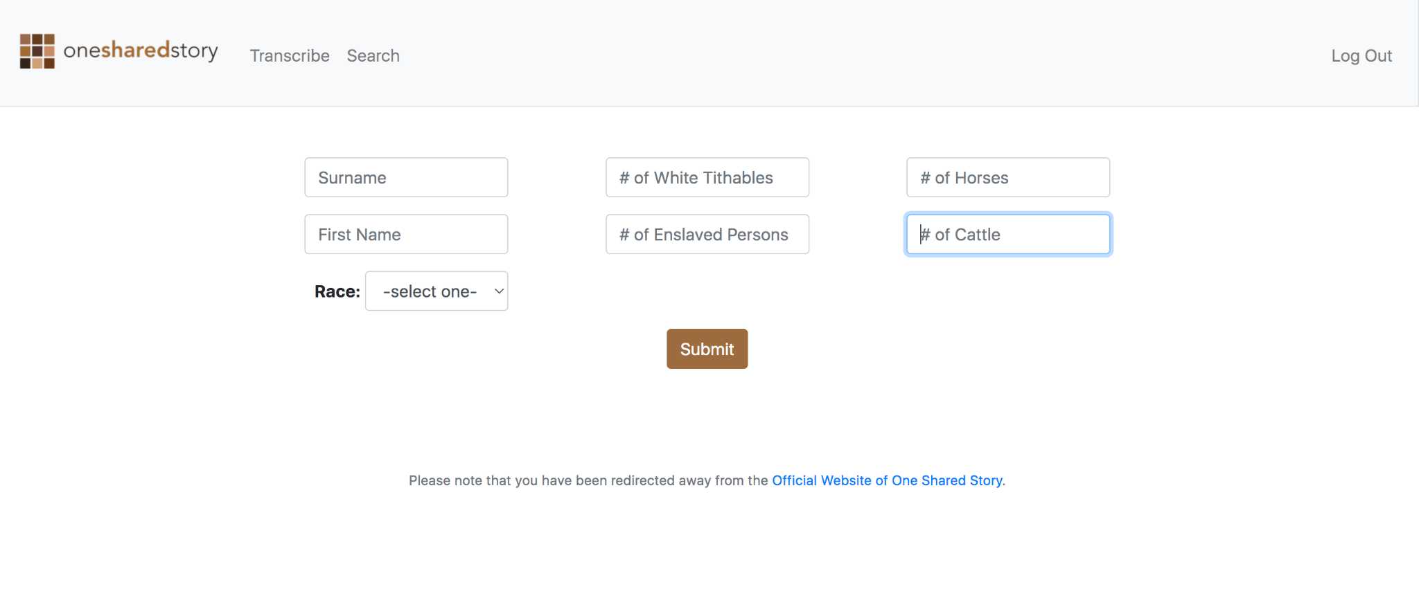
Standardize the way volunteers transcribe data
Volunteer logs into web portal
2. Volunteer input data into web form instead of excel

Slide 4
Store transcribed data in a database
Relational
Database
NoSQL
Database
vs.

Slide 5
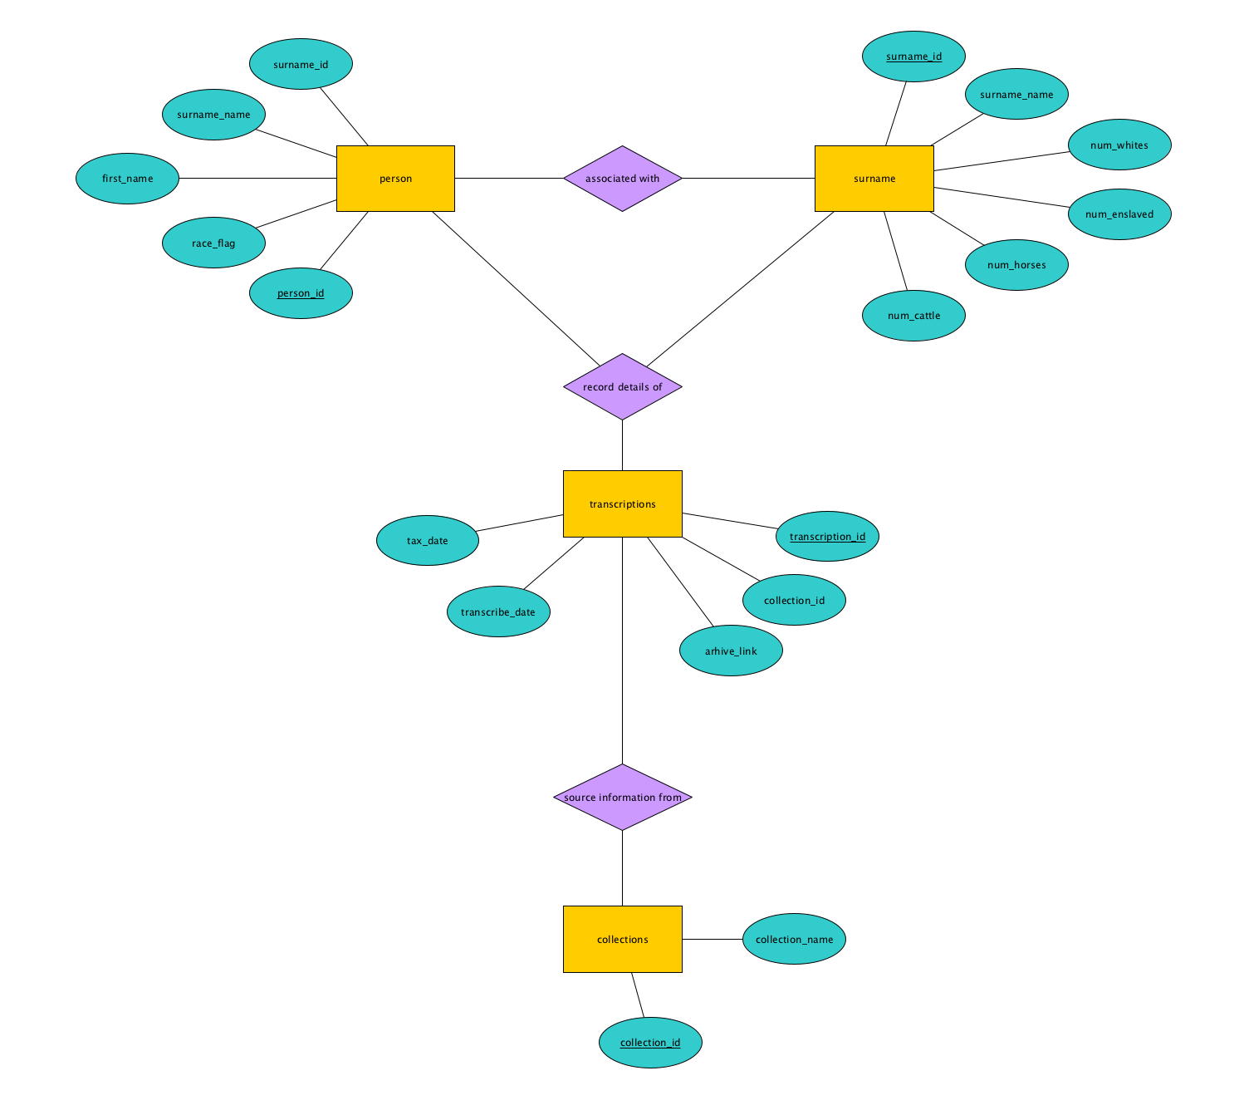
Store transcribed data in a database

Slide 6
Store transcribed data in a database
Structure
Current Data
Future Documents
SOURCE
1867 Tax Records
?
EVENTS
Person A pays taxes on ownership Person B
?
PEOPLE
Person A
Person B
?
ROLE
Landowner/Taxpayer
Enslaved taxable
?

Slide 7
Create an interactive search tool
OneSharedStory visits churches on the weekend to allow individuals to learn about their family ancestry.
Goal of this tool would be to allow these families to search for their ancestors and view information as it relates to the sources, events, people, and roles that are defined in our data model.
We must further identify the various ‘sources’ of historical records and decide on a data model prior to development of the interactive search tool.

Slide 8
Literature Reviewed
https://en.wikipedia.org/wiki/NoSQL
Two PhD Theses provided by Dr. Fox
https://www.youtube.com/watch?v=-56x56UppqQ

Slide 9
Next Actions
Speak with One Shared Story’s connection at Family Search about their approach to linking ancestry records
Receive more historical records from OneSharedStory
Make decision on Relational Database versus NoSQL
Load records into database that we decide to use
Begin exploratory data analysis to map out queries for searchable query tool
Develop ‘transcribe’ and ‘search’ tabs of software

Slide 10
Semester Timeline
All data loaded into database.
Exploratory data analysis to map out query tool.
Wrap Up/Complete Presentation
NOW - 3/3
3/17
3/24
4/7
4/21
4/28
Have first version of a MongoDB database built
Follow-up on data request
Connect with Robin’s contact about data linking
Connect database to web form/software
Build out queries in software ‘Search’ tab.

